Slide 1
Map Test Program
Progress Report - Jacob Davis

Slide 2
Objectives for Prototype
The first map prototype should take two locations and simulate navigation from some third current position to the two points, in order.
This involves several elements:
Taking input in the form of locations
Paging Google Maps for a route JSON
Displaying the route on the map using polylines
Animation and polish
Currently, the prototype does not page Google Maps or take any input. The route is manually constructed.

Slide 3
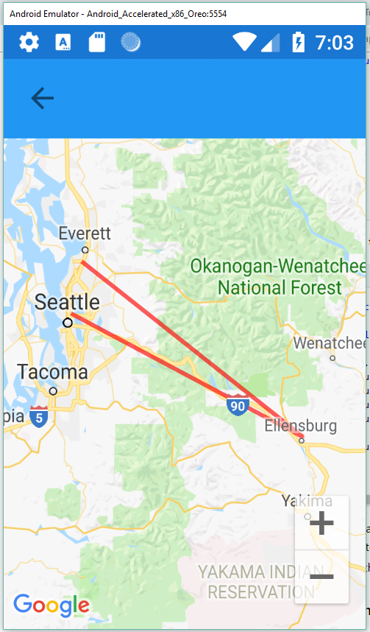
Visuals
Currently uses default Maps app with a custom renderer
Lines are drawn between the hard-coded test points
Once JSON interpretation is added, these points will become a line with many more points that actually follows the road

Slide 4
Next Iteration
JSON interpreter
More detailed route line
Animating some symbol along the line to represent the driver
Input and signal facilities for interfacing with other parts (i.e. system should know when driver has neared first destination, for example)

Slide 5
Questions?

